Slide 1
Final Term Project
To explore the feasibility of the magnetic field data in corefit of Stansby
2020.12.16(전산천문학)
202050135 홍지민
Notes:
Topic, 퍼시빌리티

Slide 2
Contents
Research Purpose
Applied Method
Code
Result
Discussion
Notes:
The table of contents was organized like this.(오거나이즈)

Slide 3
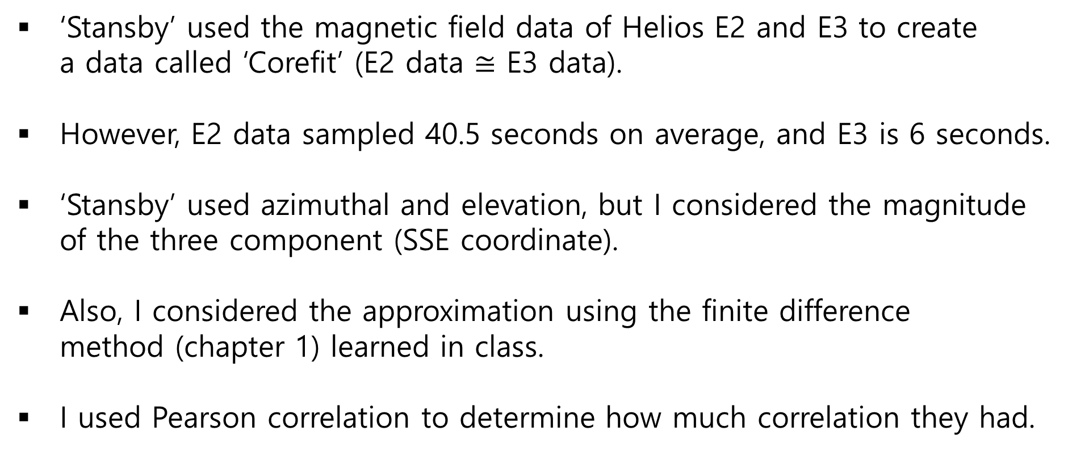
Research Purpose
‘Stansby’ used the magnetic field data of Helios E2 and E3 to create a data called ‘Corefit’ (E2 data $≅$ E3 data).
However, E2 data sampled 40.5 seconds on average, and E3 is 6 seconds.
‘Stansby’ used azimuthal and elevation, but I considered the magnitude of the three component (SSE coordinate).
Also, I considered the approximation using the finite difference method (chapter 1) learned in class.
I used Pearson correlation to determine how much correlation they had.
Notes:
There is a scientist named stansby who studied solar wind
애지뮤탈, 엘레베이션

Slide 4
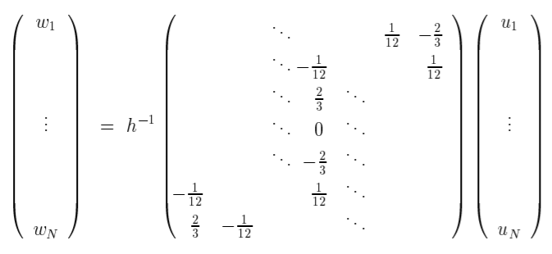
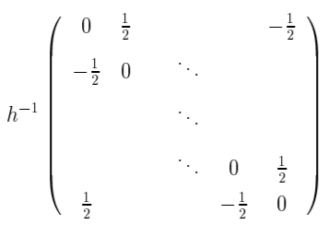
Applied Method
I used the finite difference matrix I learned in class (chapter 1).
However, although the book assumed a periodic function, the actual data are not a periodic function, so it is not possible to apply a ‘Central finite difference‘ from the boundary value.
Notes:
In periodic func, u0 is same uN, u-1 is uN-1

Slide 5
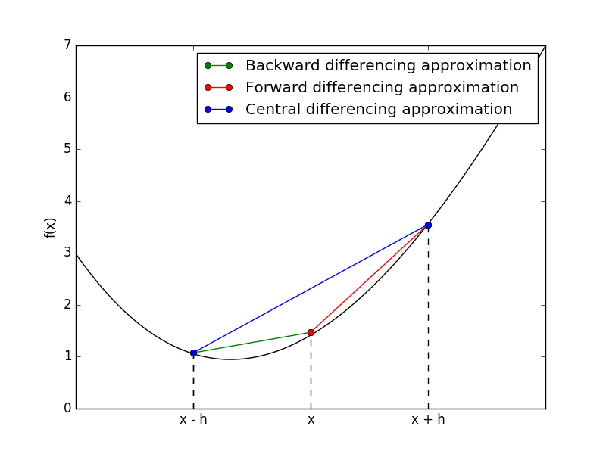
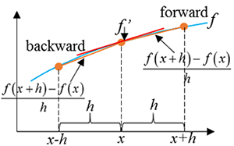
Applied Method
So I found out through Googleing that there is a method of 'forward' and 'backward'.
The forward finite difference method is a approximating values ahead of the reference point.

Slide 6

Applied Method
Conversely, the backward difference method is an approximation of the points located behind the reference point.
Also, I followed the accuracy order by referring to Wikipedia.

Slide 7
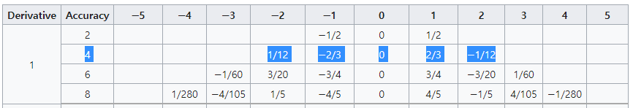
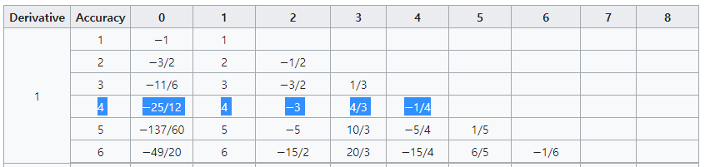
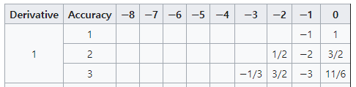
Applied Method
Central
Forward
Backward
Notes:
The coefficient corresponding to the 4 accuracy of the backward finite difference method was applied by reference to the front differential method.
made by reference

Slide 8
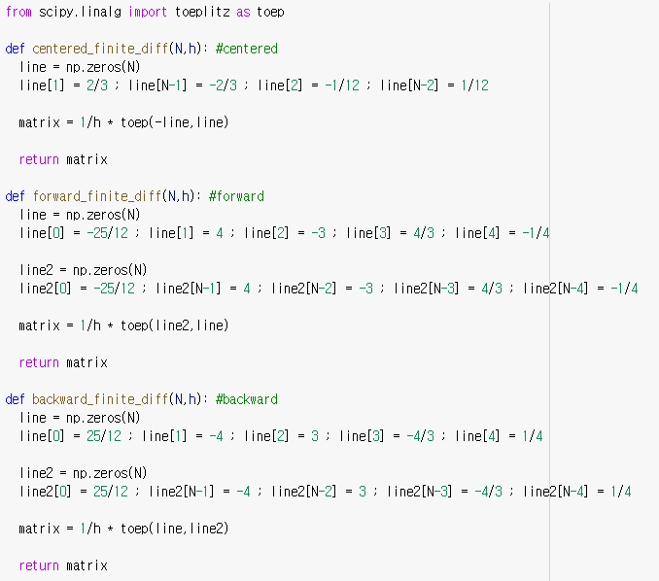
Code

Slide 9
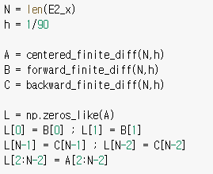
Code
Forward finite difference Matrix
1~2 rows
L =
All Accuracy = 4
Backward finite difference Matrix
(N-1)~N rows
The approximation was calculated using this L matrix.

Slide 10
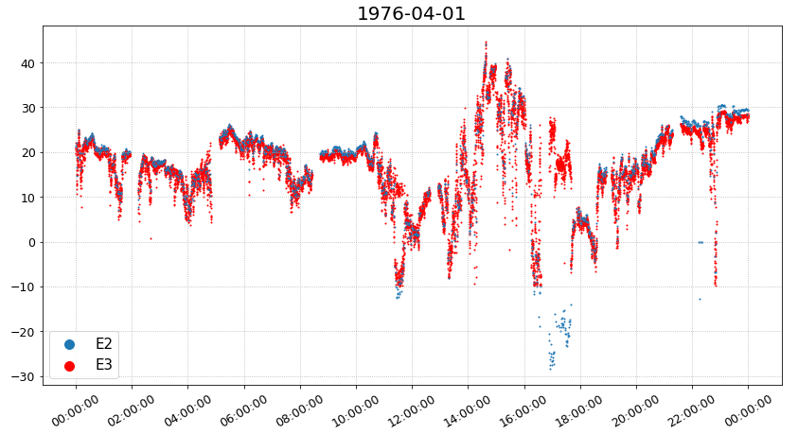
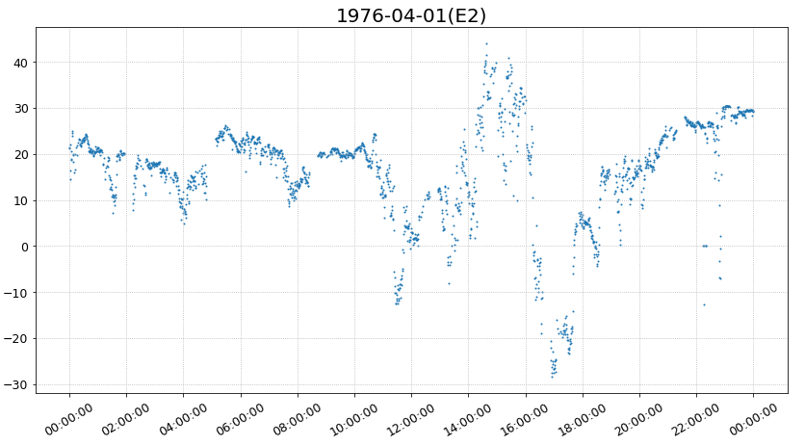
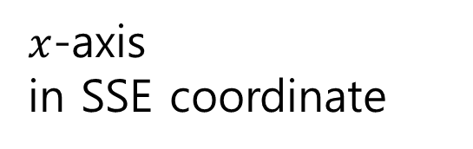
Result
First, I compared E2 and E3 data by drawing them in a scatter plot.
$x$-axis in SSE coordinate
There is a similar tendency.
Notes:
April 1st, be quite similar

Slide 11
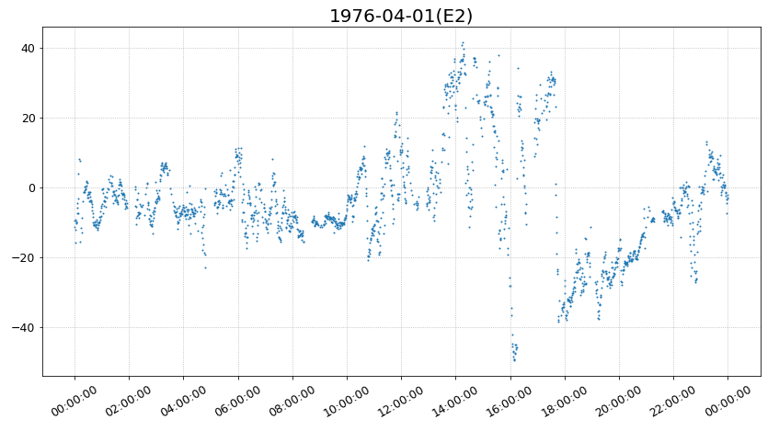
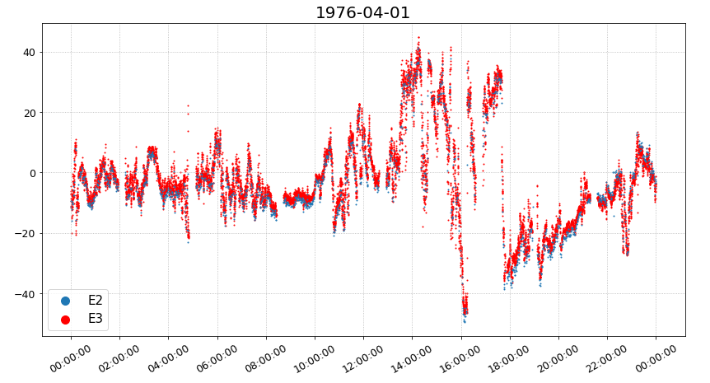
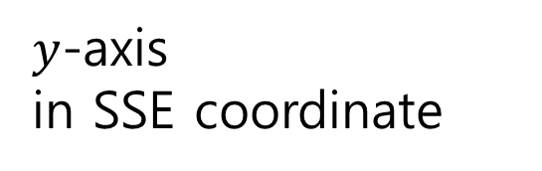
Result
First, I compared E2 and E3 data by drawing them in a scatter plot.
$y$-axis in SSE coordinate
There is a similar tendency.

Slide 12
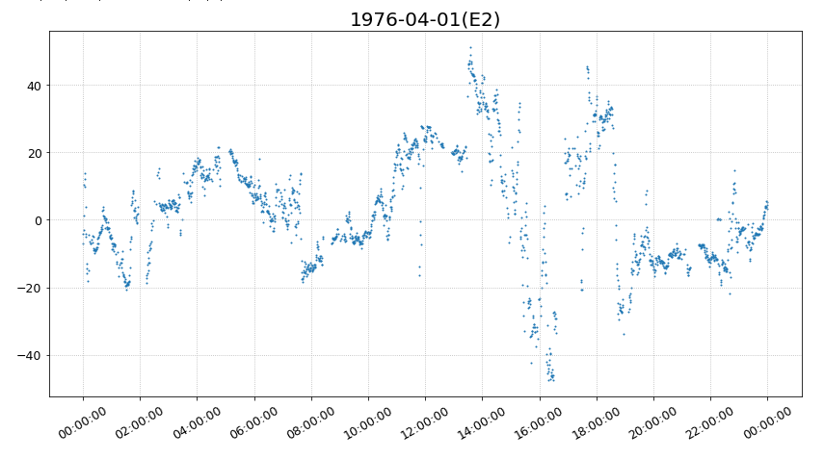
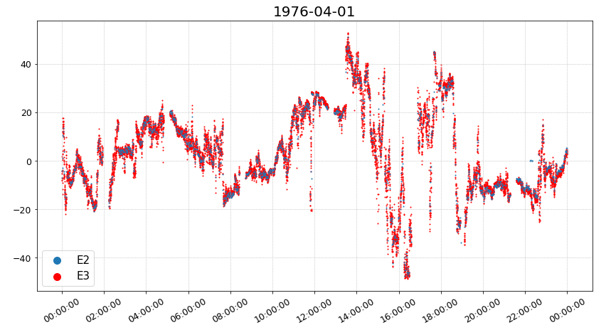
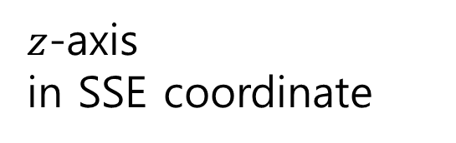
Result
First, I compared E2 and E3 data by drawing them in a scatter plot.
$z$-axis in SSE coordinate
There is a similar tendency.

Slide 13
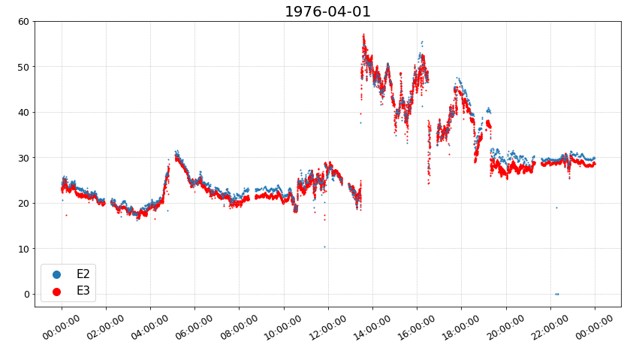
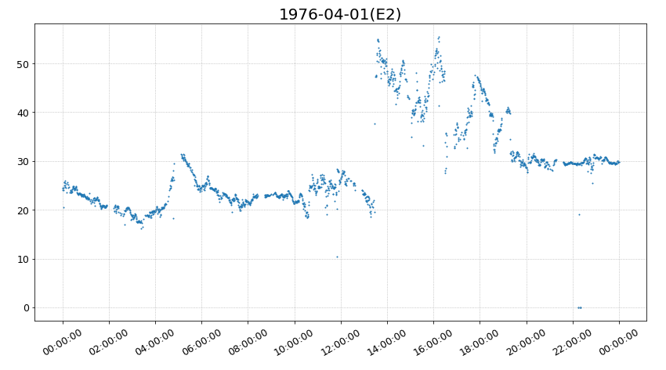
Result
First, I compared E2 and E3 data by drawing them in a scatter plot.
Magnitude in SSE coordinate
There is a similar tendency.

Slide 14
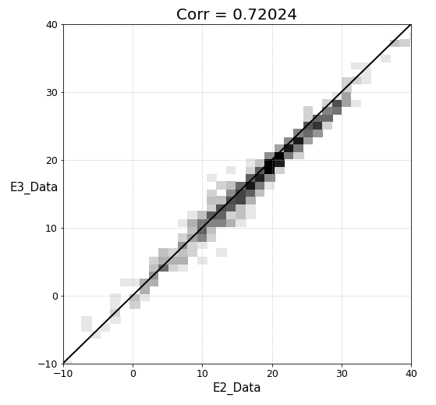
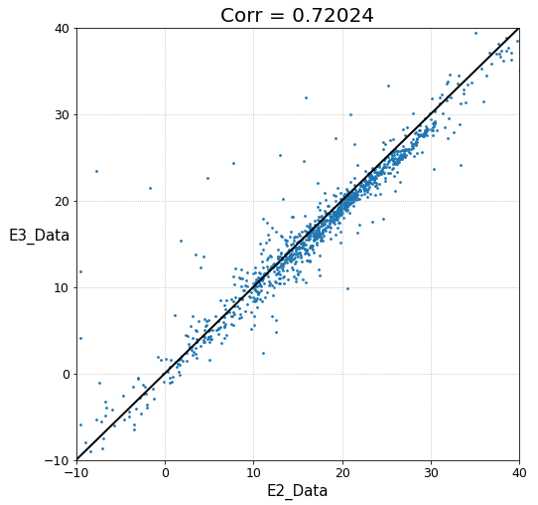
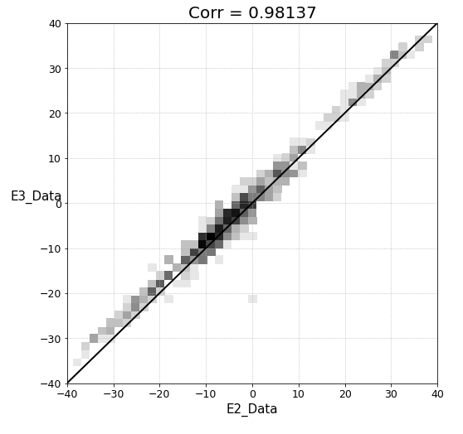
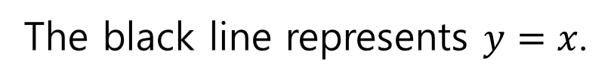
Result
The black line represents $y=x$.
Notes:
A darker black color means there is a lot of data.

Slide 15
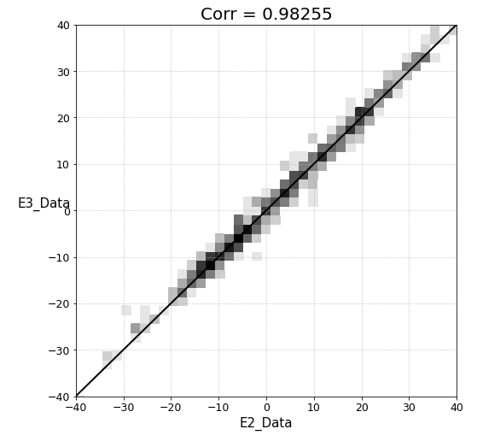
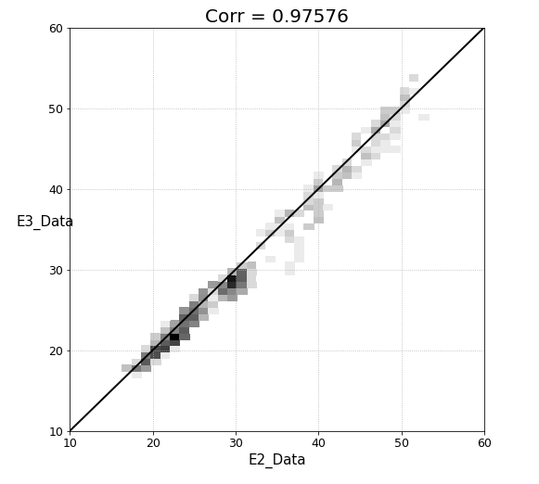
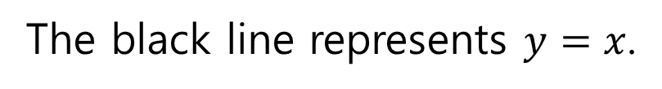
Result
The black line represents $y=x$.

Slide 16
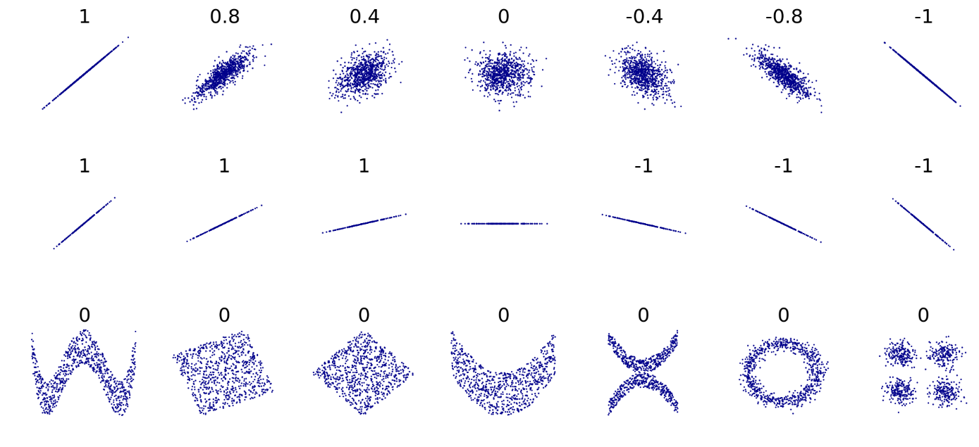
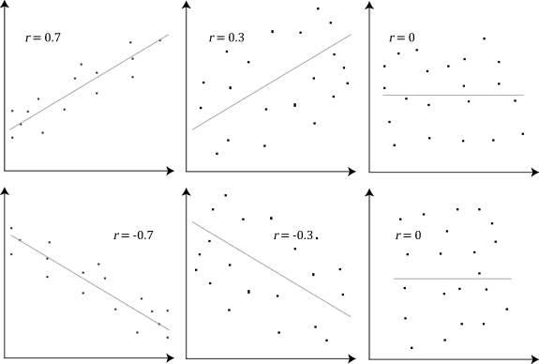
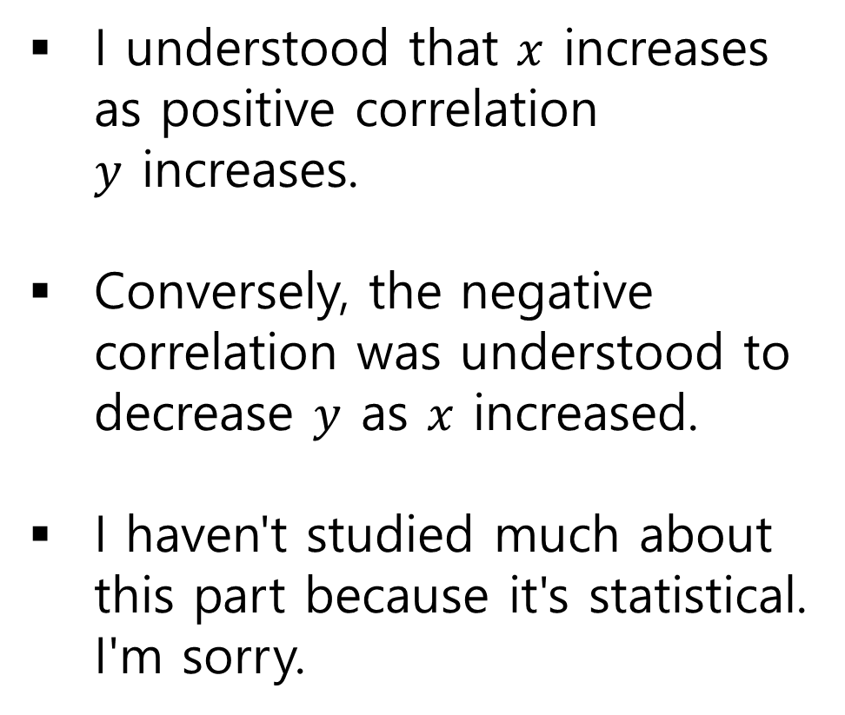
Pearson C.C
I understood that $x$ increases as positive correlation $y$ increases.
Conversely, the negative correlation was understood to decrease $y$ as $x$ increased.
I haven't studied much about this part because it's statistical. I'm sorry.
Notes:
What is Pearson C.C

Slide 17
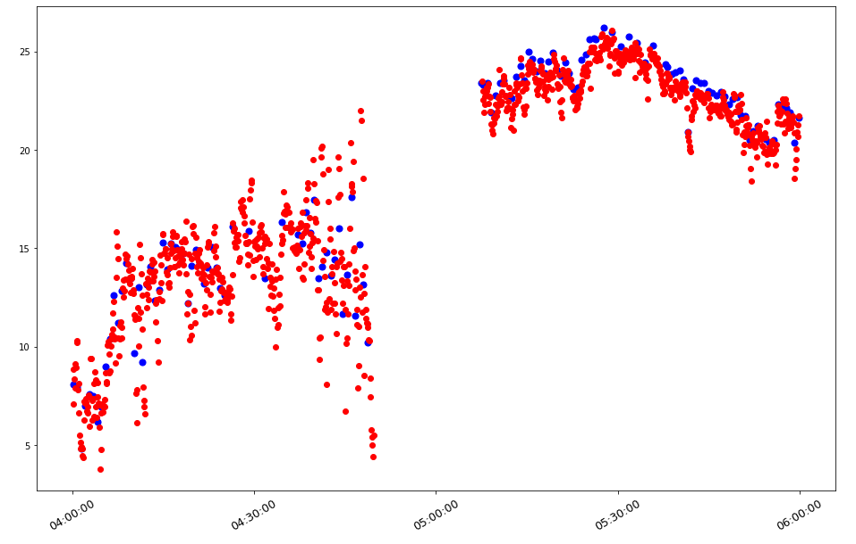
Result
Second, I tried to interpolation and regression
Because there are empty gaps and not uniform in the data, interpolation was implemented as a whole.
Later, an approximation was obtained using a regression equation.
 | E2 | E3
Grid Point | Ave 40 sec | Ave 6 sec
No. Strange Data (1976.4.1) | 152 / 1772 (8.58%) | 45 / 13004 (0.346%)
Not uniform
Notes:
임플리멘티드. E2는 8.58%, E3는 0.346%

Slide 18
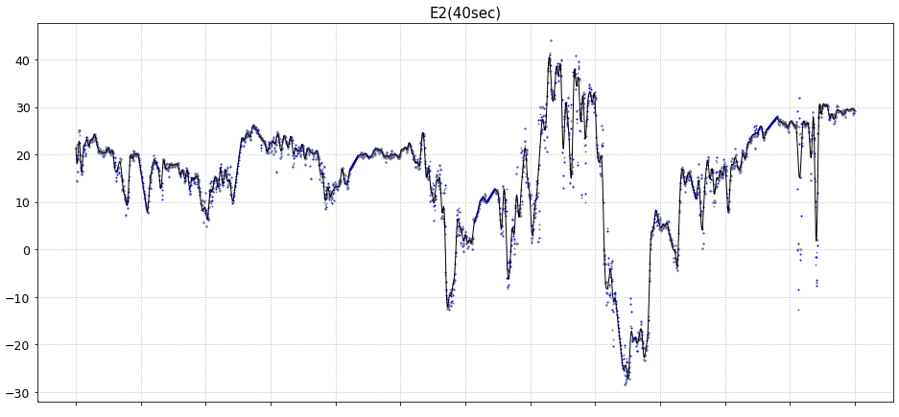
Result
Black line : Reg(SVR), Grey point : Origin point, Blue point : Inter point

Slide 19
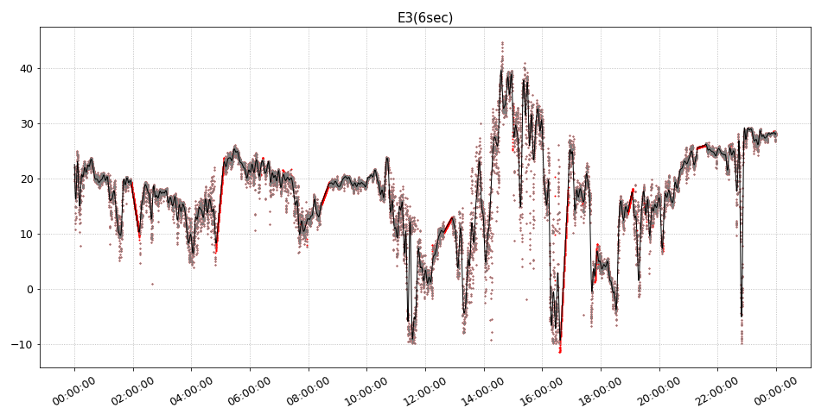
Result
Black line : Reg(SVR), Grey point : Origin point, Red point : Inter point

Slide 20
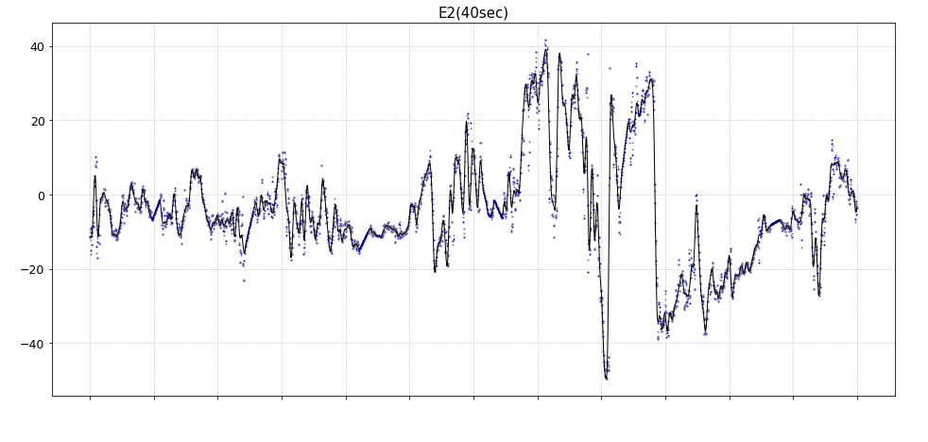
Result
Black line : Reg(SVR), Grey point : Origin point, Blue point : Inter point

Slide 21
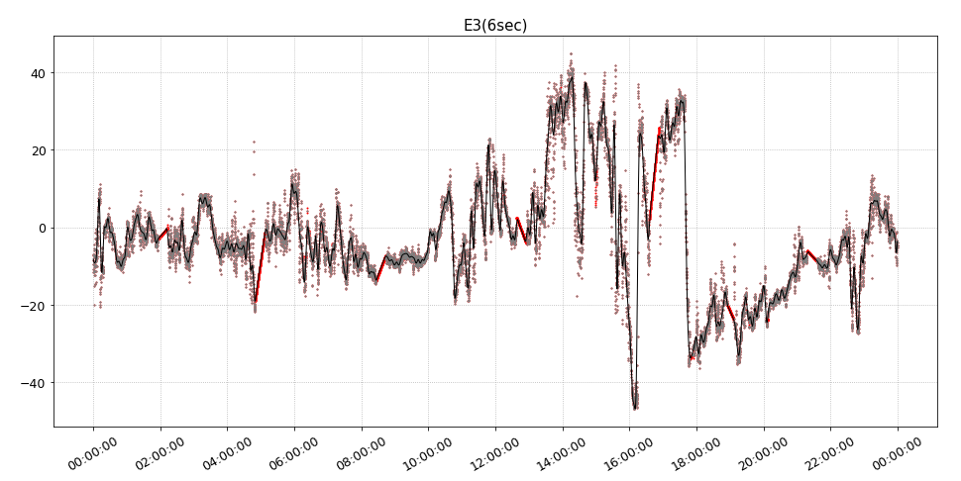
Result
Black line : Reg(SVR), Grey point : Origin point, Red point : Inter point

Slide 22
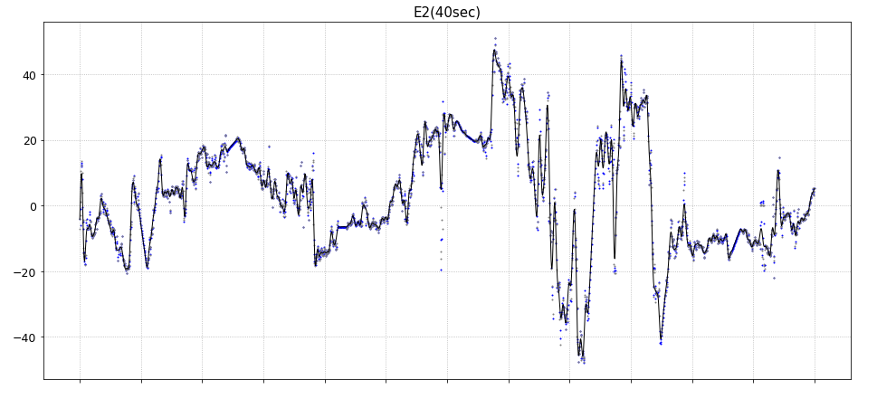
Result
Black line : Reg(SVR), Grey point : Origin point, Blue point : Inter point

Slide 23
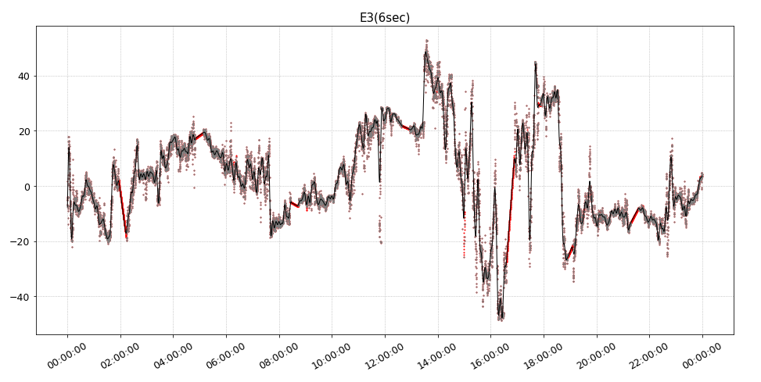
Result
Black line : Reg(SVR), Grey point : Origin point, Red point : Inter point

Slide 24
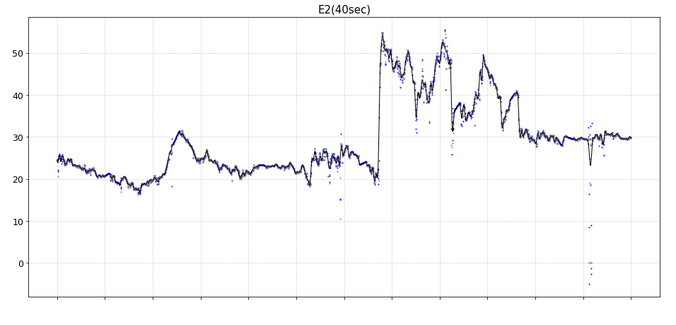
Result
Black line : Reg(SVR), Grey point : Origin point, Blue point : Inter point

Slide 25
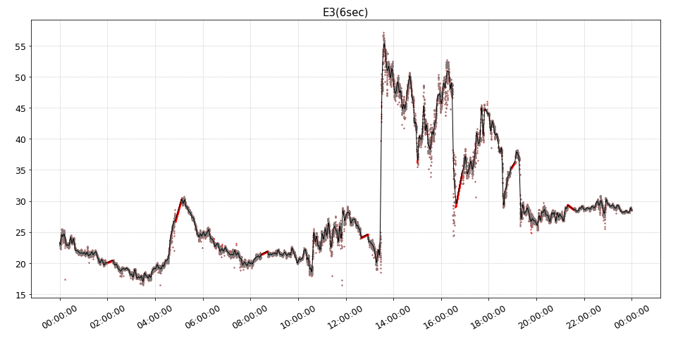
Result
Black line : Reg(SVR), Grey point : Origin point, Red point : Inter point

Slide 26
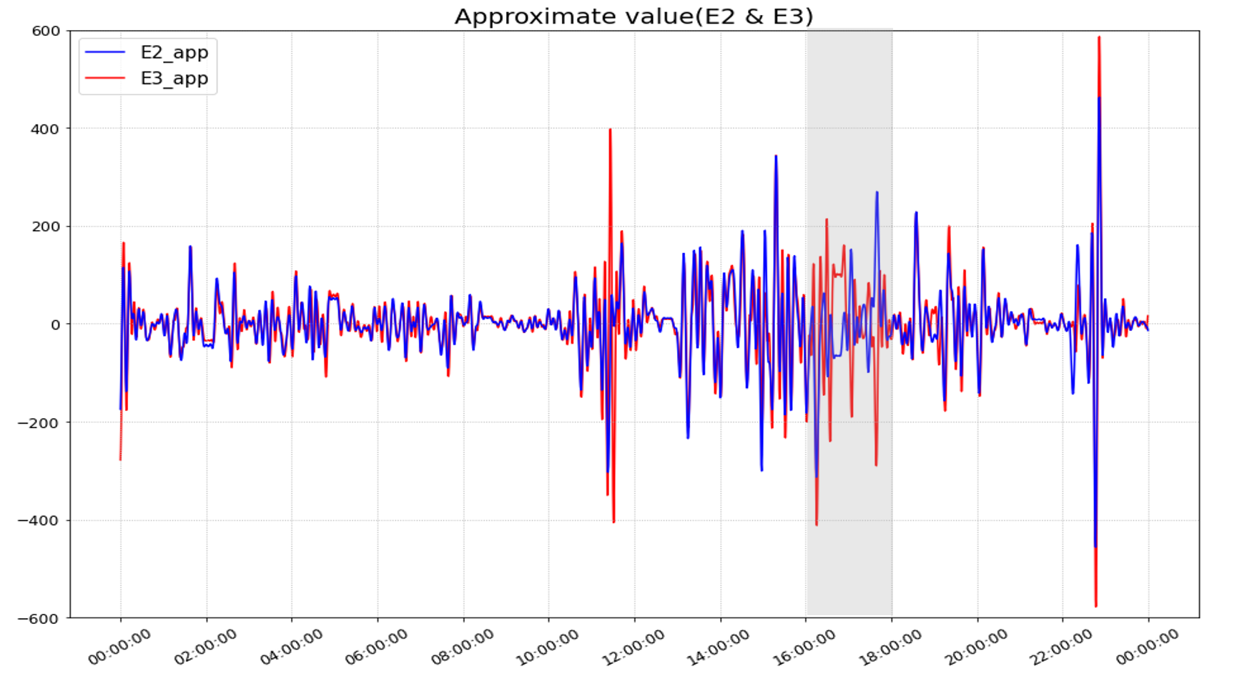
Result

Slide 27
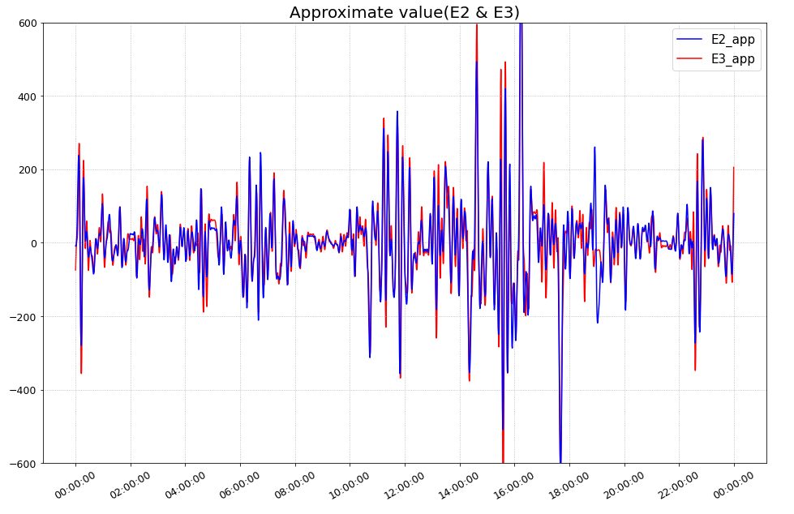
Result

Slide 28
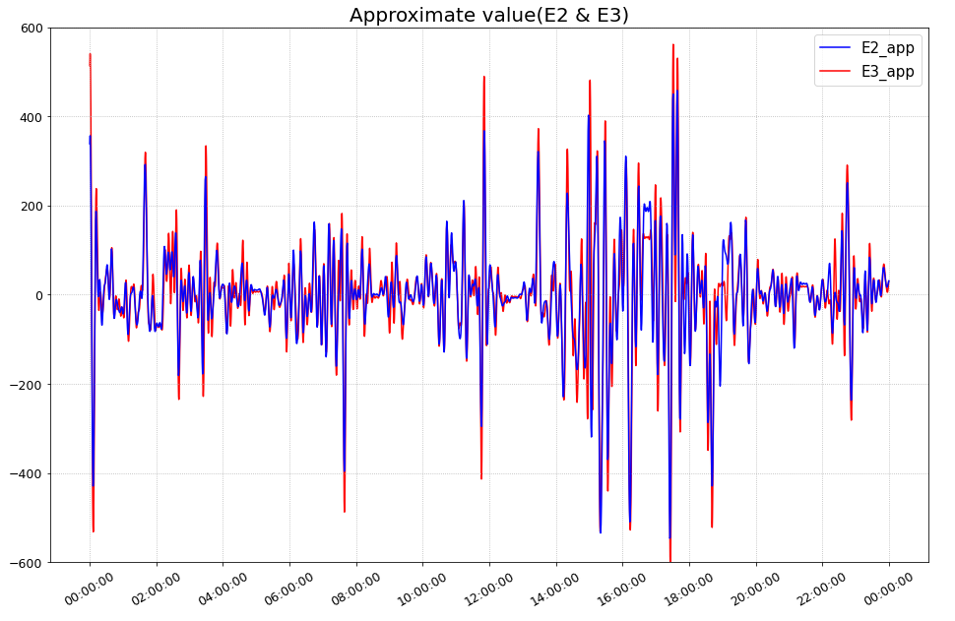
Result

Slide 29
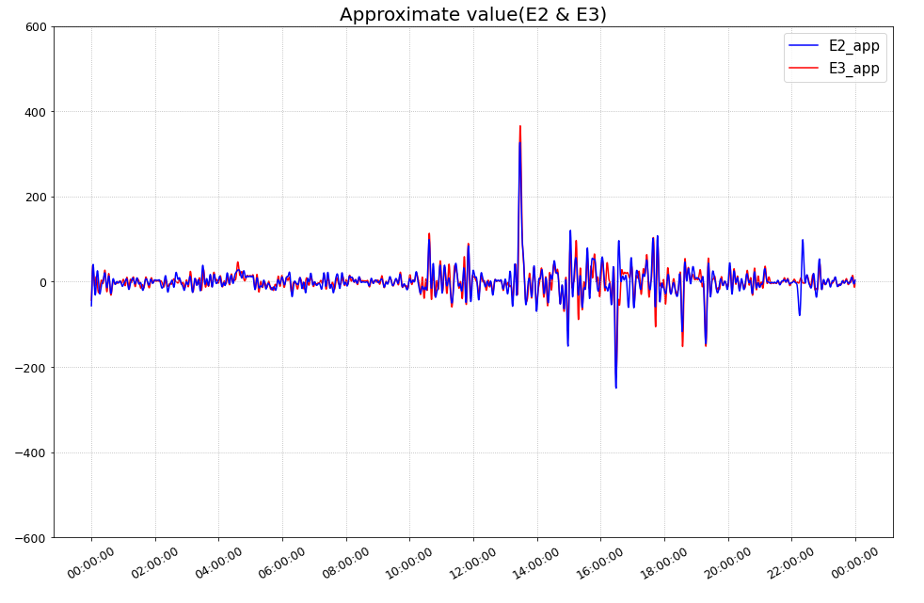
Result

Slide 30
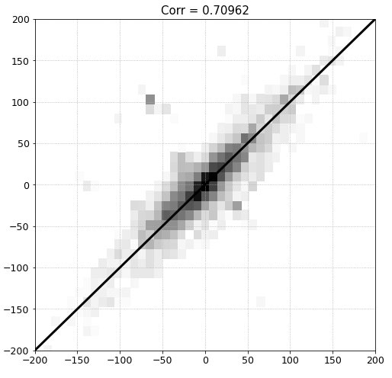
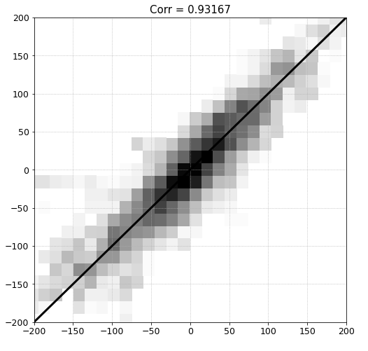
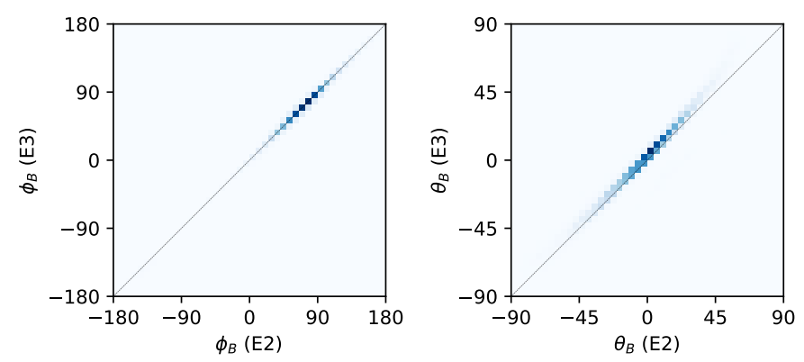
Result
If the count in bin is less than five, it is not drawn.
It can be seen that it is more widely spread than the values considered for azimuthal and elevation.

Slide 31
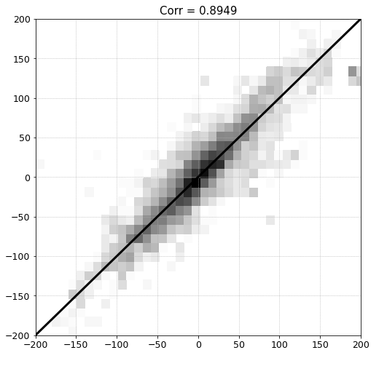
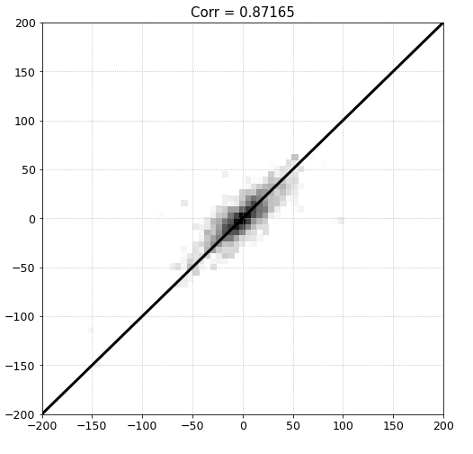
Result

Slide 32
Discussion
The time from 16H to 18H tends to not fit well. This is thought to be the difference between grid period or by measurement method.
The Pearson correlation coefficient is 0.7 to 0.9 and indicates good correlation just by the magnitude of each vector component other than the azimuthal and elevation.
It seems that data from empty part can be interpolated through machine learning (Requires further study).
'Corefit' using E2 and E3 data by Stansby is thought to be reasonable enough data.
Regardless of the grid period, the data in E2 and E3 have similar values and the approximate differences have similar values, so the two data can be used interchangeably.

